Slide 1
Web Technologies
Webpage Design guidelines
HTML 5

Slide 2
Summary of Today’s Lecture
Web page design
HTML5 Introduction
HTML5 Semantic Elements
HTML5 Forms
Input Types
Form Attributes
HTML5 Audio & Video Elements

Slide 3
Good web applications: Design + Implementation
Some Design Goals:
Intuitive to use
Don't need to take a course or read a user manual
Accomplish task accurately and rapidly
Provide needed information and functionality
Users like the experience
Joy rather than pain when using the app
The hardest part of good web applications is the design
Outside the scope of this course (and instructor)!
Good user interface principles are encoded in the toolkits and style guides

Slide 4
Some guiding design principles for Web Apps
Be consistent
Cognitive load less for the user
Provide context
User shouldn't get lost in the app
Be fast
Don't make the user wait

Slide 5
Consistency: Style guides & design templates
Web apps should have a style guide - Covers the look and feel of the app
Style - Color schemes, animation, icons, images, typography, writing
User interactions - Menu, buttons, pickers, dialog boxes, tables, lists, ...
Layout - Structure, toolbars, content, responsiveness
Patterns - If you do something multiple places do it the same way
Aided by reusable implementation components
Error handling, navigation, notifications, etc.
Design templates - Follow a familiar structure
Example: Master-detail template

Slide 6
Style Guide Example: Material Design from Google
Used in Google apps (e.g Android, web apps)
Influence by publishing (paper and ink) enhance with technology (3D look)
Focus on traditional print issues: grids, space, typography, scale, color, imagery
Heavy use of animation to convey action
Dictates many aspect of design
Structure and layouts
User interface
Common patterns

Slide 7
Material Design Foundations
Environment - surfaces (e.g paper), depth, and shadows
Layout - responsive layout grid, breakpoints, white space
Navigation - changing views: Lateral, Forward, Backward
Color - recommendations for colors that work well together
Typography - recommendations for point size, weight, spacing
Iconography - visual expressions (language independent)
Shape - use different shapes to direct attention, identify, communicate
Motion - show information (e.g. relationships), focus attention, fun
Interaction - map touch to actions
Communication - writing, formats, imagery, launch screen, onboarding

Slide 8
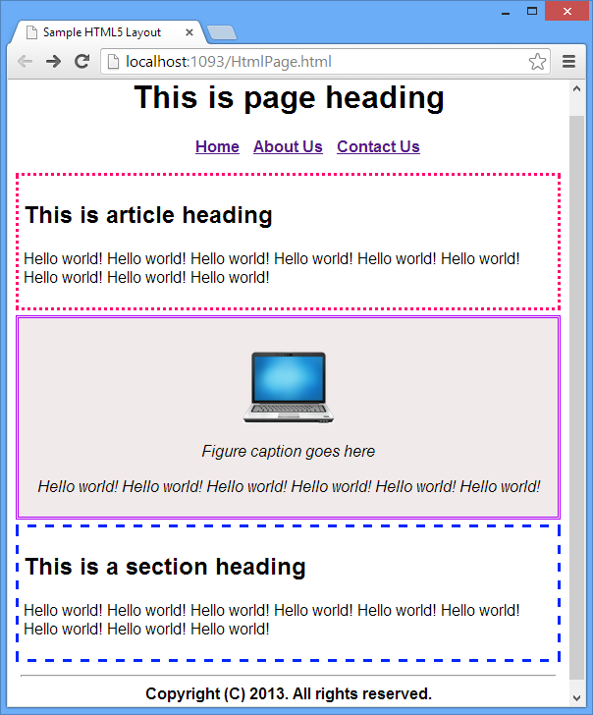

Slide 9
HTML5
HTML5 is the fifth and latest major version of HTML that is a World Wide Web Consortium (W3C) recommendation.
HTML5 was first released in public-facing form on 22 January 2008, with a major update and "W3C Recommendation" status in October 2014.
Its goals are to improve the language with support for the latest multimedia and other new features; to keep the language both easily readable by humans and consistently understood by computers and devices such as web browsers, parsers, etc.,
The current specification is known as the HTML Living Standard and is maintained by a consortium of the major browser vendors (Apple, Google, Mozilla, and Microsoft), the Web Hypertext Application Technology Working Group (WHATWG).
https://www.w3.org/blog/news/archives/7753

Slide 10
HTML5 Semantic Elements
A semantic element clearly describes its meaning to both the browser and the developer.
Examples of non-semantic elements: <div> and <span> - Tells nothing about its content.
Examples of semantic elements: <header>, <footer>, and <article> - Clearly defines its content.
HTML5 introduces new semantic elements:
<article> <aside> <details> <figcaption> <figure> <footer> <header> <main> <mark> <nav> <section> etc.

Slide 11
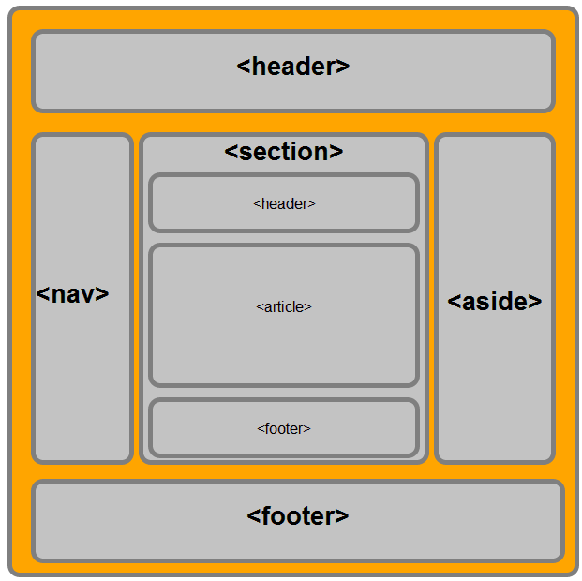
HTML5 Structure Semantic Elements
Following is the list of HTML 5 semantic elements to define structure of the HTML page.
<header> defines header region of page or section.
<footer> defines footer region of page or section.
<nav> defines navigation region of page or section.
<section> defines logical section of page or a grouping of related content.
<article> defines an article or complete piece of content.
<aside> defines secondary or related content.

Slide 12
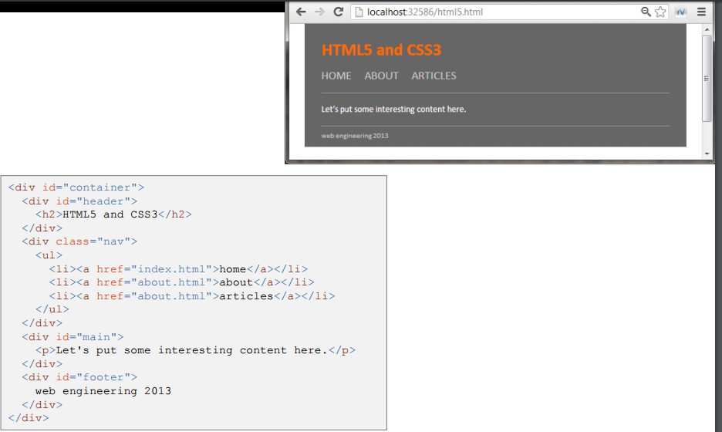
Using <div> for structuring your page?
In <div> tag you have to give an id or class which tells about what kind of content it is holding, either body or header or footer etc.
In case of semantic elements of HTML5, the name clearly defines what kind of code it is holding, and it is for which part of the website.

Slide 13
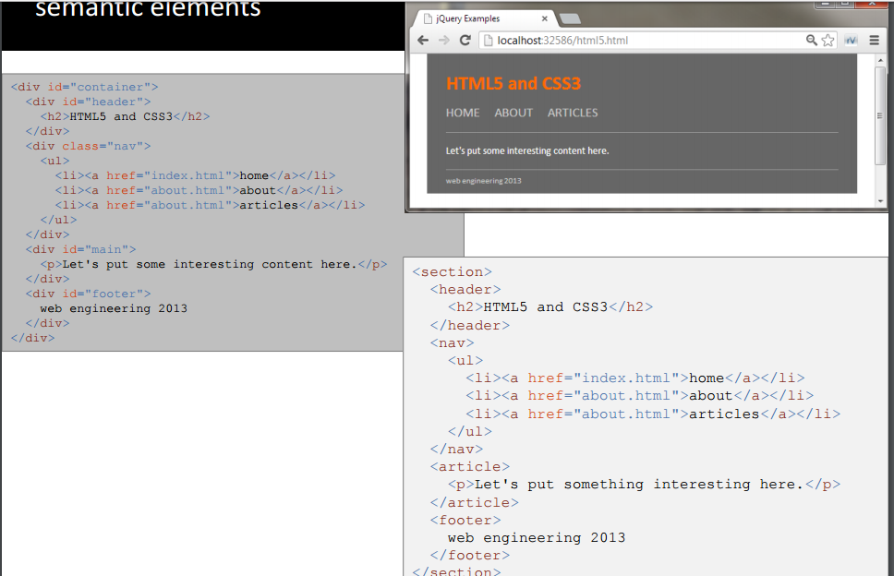
Semantic Elements

Slide 14
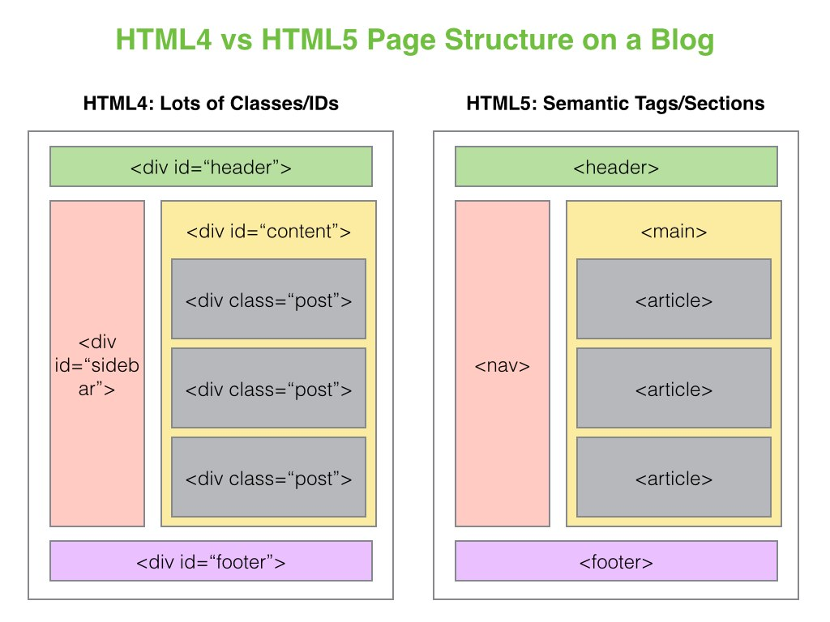

Slide 15
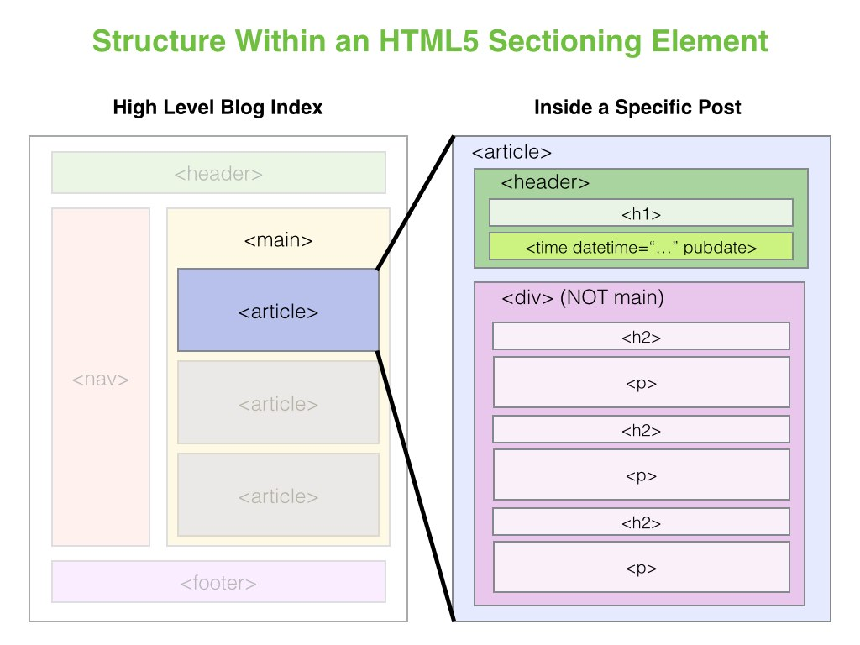

Slide 16
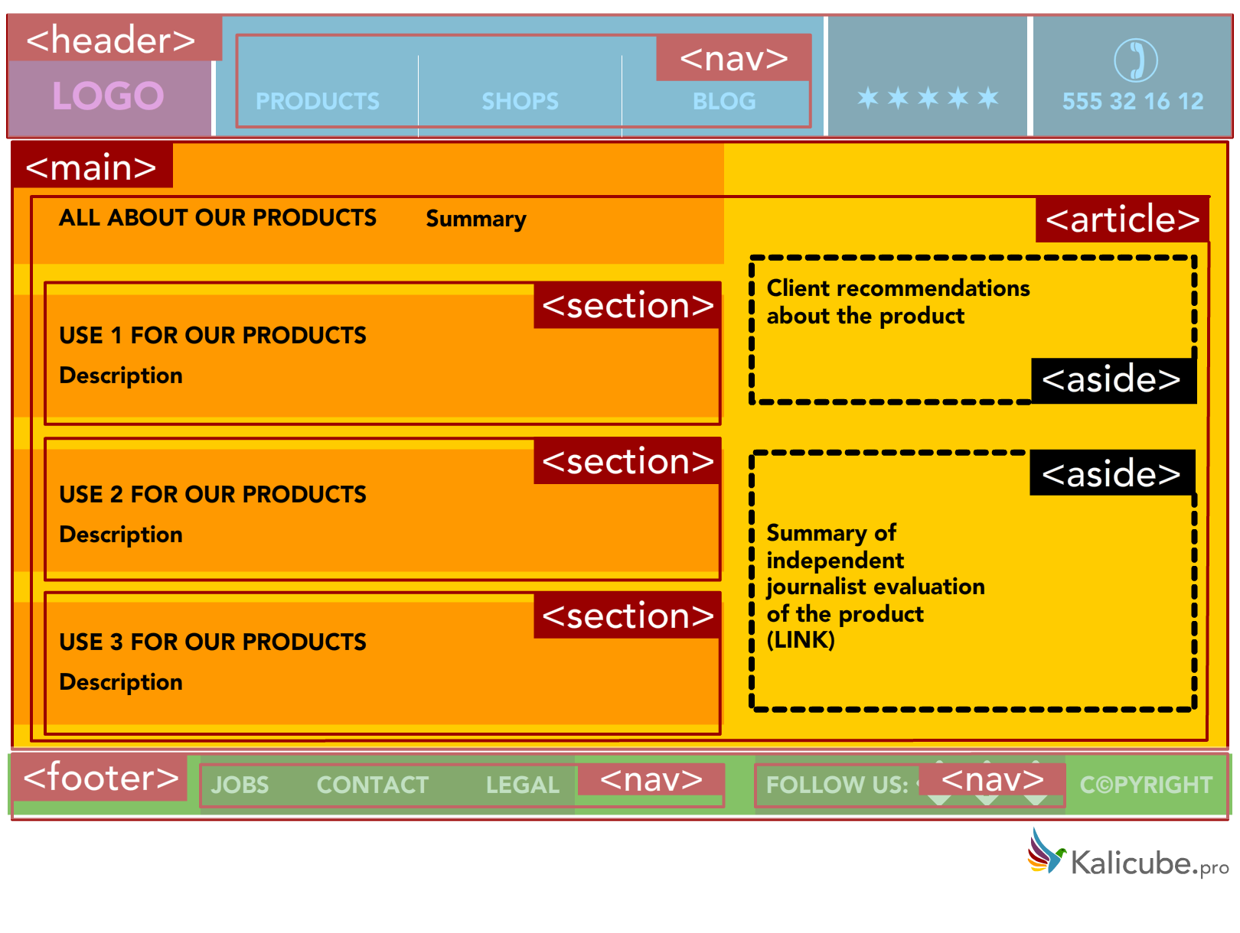

Slide 17
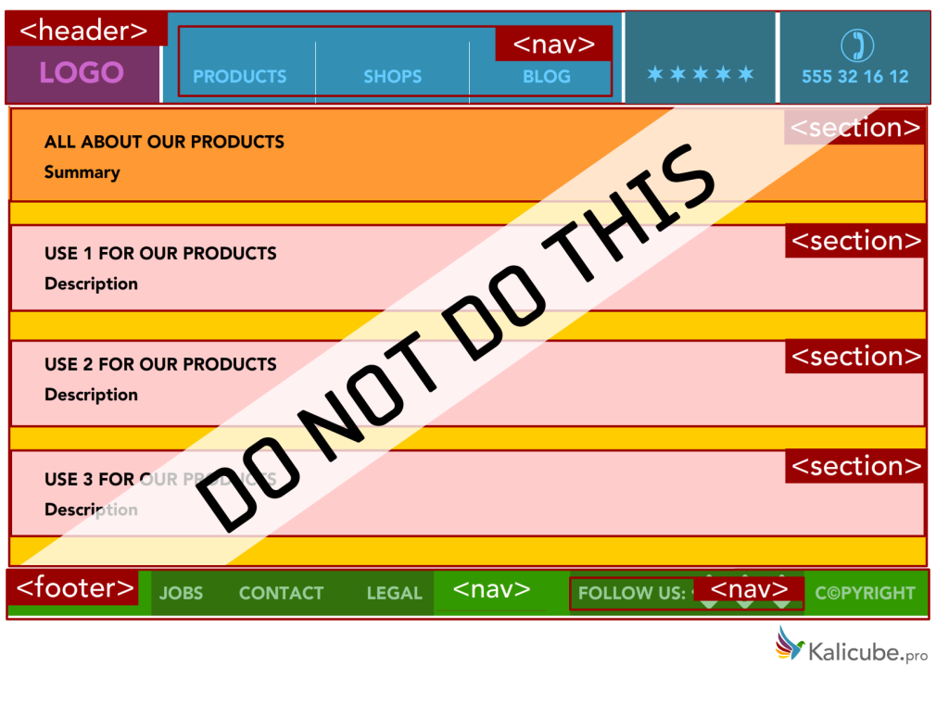
This (surprisingly typical) example simply duplicates the visual layout. Worse than pointless, this indicates that the page contains 4 different topics, rather than one topic and 3 sub-topics.

Slide 18
Why use HTML5 Semantic elements?
When a page is well designed visually, it is easy to identify the various parts of a web page at a glance.
For users who are visually impaired, proper use of HTML5 semantic elements will allow screen readers to more accurately communicate your content by making the visual audible.
When Googlebot and Bingbot store the crawled pages in their index, they add a rich layer of annotation. It is that annotative layer that the ranking algorithms use to find and extract content from individual webpages.
Richer and more accurate annotation makes for better findability and increases the chances of any given piece of content being considered for ranking by the algorithms.
So, the correct use of semantic HTML5 gives your content an advantage in the selective process that is right at the foundation of ranking. It increases the chances that the ranking algorithms will select your content as a candidate for ranking in the first place.

Slide 19
HTML 5 Forms
HTML5 has introduced new form elements, input types, attributes, and other features.
Before we had to use JavaScript to create such behaviors which are now available directly in the browser.
All you need to do is set an attribute in your markup to make them available.
For Example, with HTML5 attributes client-side validation being handled natively by the browser, which was performed with JavaScript earlier on.
This will result in greater consistency across different sites, and many pages will load faster without all that redundant JavaScript.

Slide 20
HTML5 Form Input Types
HTML5 gives us input types that provide for more data-specific UI elements and native data validation.
HTML5 has a total of 13 new input types:
search
Email
url
Tel
Number
Range
color
datetime
date
Month
Week
Time
datetime-local

Slide 21
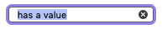
HTML5 Form Input Types - search
The search input type (type="search") provides a search field intended to be used to create search boxes on pages and apps. This type of field is set by using the value search for the type attribute:
<input type="search" id="search" name="search">
The main difference between a text field and a search field is how the browser styles its appearance.
Often, search fields are rendered with rounded corners; they also sometimes display an "Ⓧ", which clears the field of any value when clicked).
Another feature worth noting is that the values of a search field can be automatically saved and re-used to offer auto-completion across multiple pages of the same website; this tends to happen automatically in most modern browsers.

Slide 22
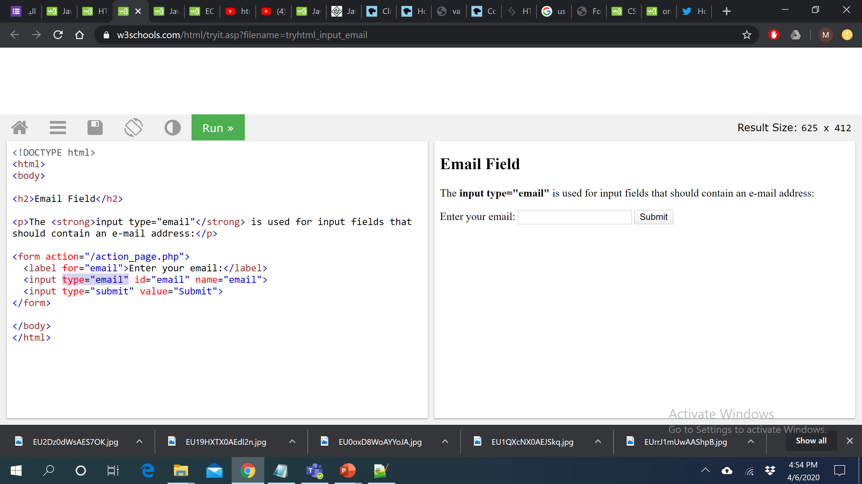
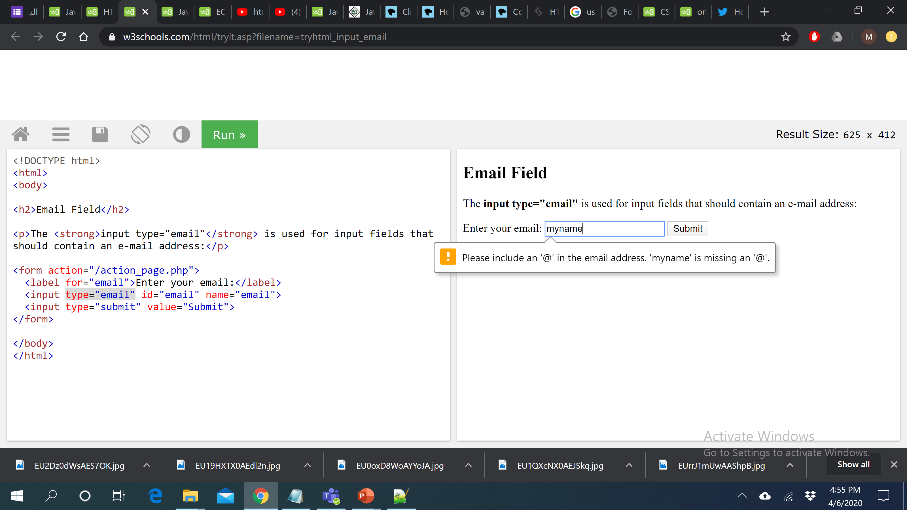
HTML5 Form Input Types - email
The email type (type="email") is, unsurprisingly, used for specifying one or more email addresses.
This type of field is set using the value email for the type attribute:
<input type="email" id="email" name="email">
You can also use the multiple attribute in combination with the email input type to allow several email addresses to be entered in the same input (separated by commas):
<input type="email" id="email" name="email" multiple>

Slide 23
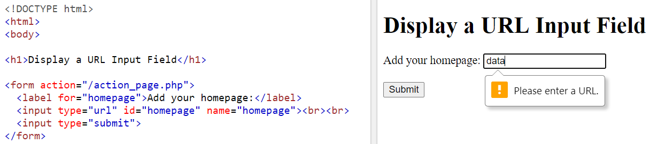
HTML5 Form Input Types - url
The url input (type="url") is used for specifying a web address
A special type of field for entering URLs can be created using the value url for the type attribute:
<input type="url" id="url" name="url">
It adds special validation constraints to the field. The browser will report an error if no protocol (such as http:) is entered, or if the URL is otherwise malformed.
On devices with dynamic keyboards, the default keyboard will often display some or all of the colon, period, and forward slash as default keys.

Slide 24
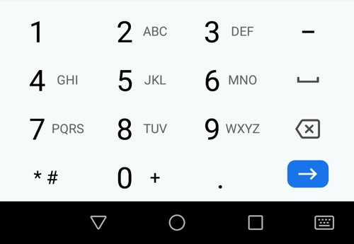
HTML5 Form Input Types - tel
A special field for filling in phone numbers can be created using tel as the value of the type attribute:
<input type="tel" id="tel" name="tel">
When accessed via a touch device with a dynamic keyboard, most devices will display a numeric keypad when type="tel" is encountered, meaning this type is useful whenever a numeric keypad is useful, and doesn't just have to be used for telephone numbers.

Slide 25
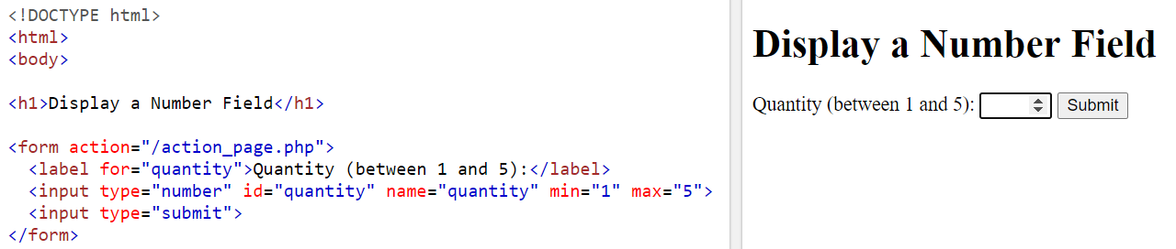
HTML5 Form Input Types - number
The number type (type="number") provides an input for entering a number.
Usually, this is a “spinner” box, where you can either enter a number or click on the up or down arrows to select a number.
The example below creates a number control whose value is restricted to any value between 1 and 5, and whose increase and decrease buttons change its value by 2.
<input type="number" name="age" id="age" min="1" max=“5" step="2">
Use the following attributes to specify restrictions:
max - specifies the maximum value allowed
min - specifies the minimum value allowed
step - specifies the legal number intervals
value - Specifies the default value

Slide 26
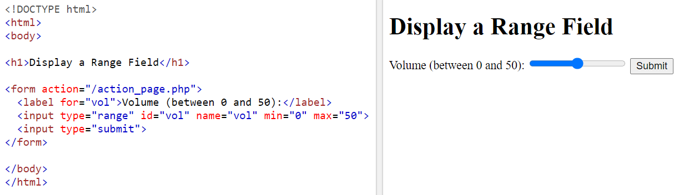
HTML5 Form Input Types - range
The range input type (type="range") displays a slider control in browsers that support it.
As with the number type, it allows the min, max, and step attributes.
The difference between number and range, according to the spec, is that the exact value of the number is unimportant with range.
It’s ideal for inputs where you want an imprecise number; for example, a customer satisfaction survey asking clients to rate aspects of the service they received.
<label for="price">Choose a maximum house price: </label>
<input type="range" name="price" id="price" min="50000" max="500000" step="100" value="250000">

Slide 27
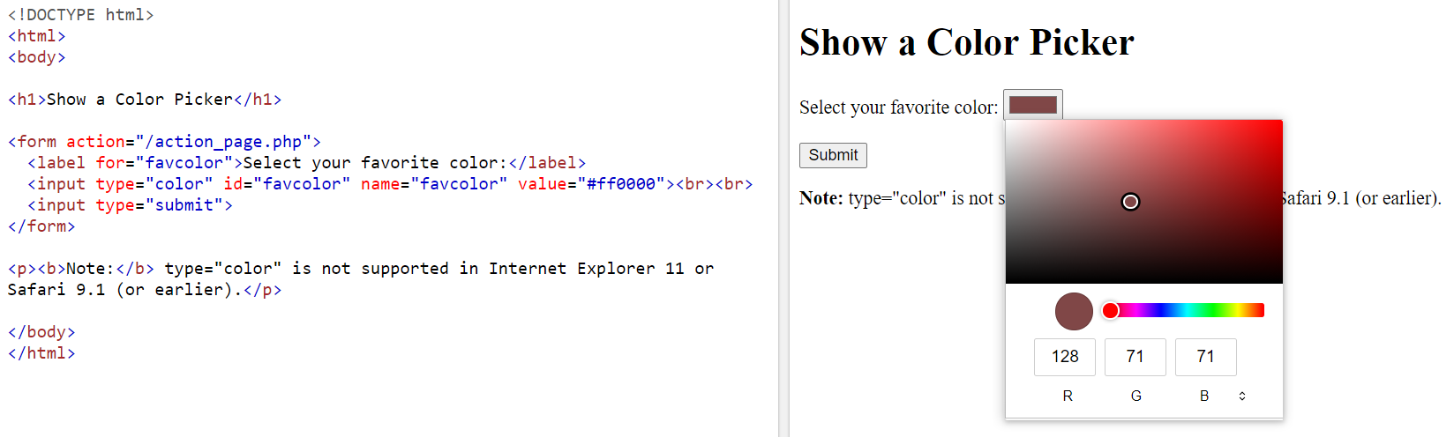
HTML5 Form Input Types - color
The color input type (type="color") provides the user with a color picker.
A color control can be created using the <input> element with its type attribute set to the value color:
<input type="color" name="color" id="color">
The color picker should return a hexadecimal RGB color value, such as #FF3300.

Slide 28
HTML5 Form Input Types - date and time
There are several new date and time input types, including date, datetime, datetime-local, month, time, and week.
All date and time inputs accept data formatted according to the ISO 8601 standard.
A date and time control is created using the <input> element and an appropriate value for the type attribute, depending on whether you wish to collect dates, times, or both.
date – It selects date, month and year, for example, 24-06-2004.
month – It selects month and year for example, 12-2012.
<input type="month" name="month" id="month">
week - Selects week and year for example, W01-2012.
<input type="week" name="week" id="week">
time - Selects time (hour and minute)‏ for example, 22:00
<input type="time" name="time" id="time">
datetime - Selects time, date, month and year
datetime-local - Selects time, date, month and year (local time)‏
<input type="datetime-local" name="datetime" id="datetime">

Slide 29
HTML5 Form Input Attributes
For years, developers have written (or copied and pasted) snippets of JavaScript to validate the information users entered into form fields: what elements are required, what type of data is accepted, and so on.
HTML5 provides us with several attributes that allow us to dictate what is an acceptable value, and inform the user of errors, all without the use of any JavaScript.
required
placeholder
pattern
disabled
readonly
multiple
autocomplete
autofocus

Slide 30
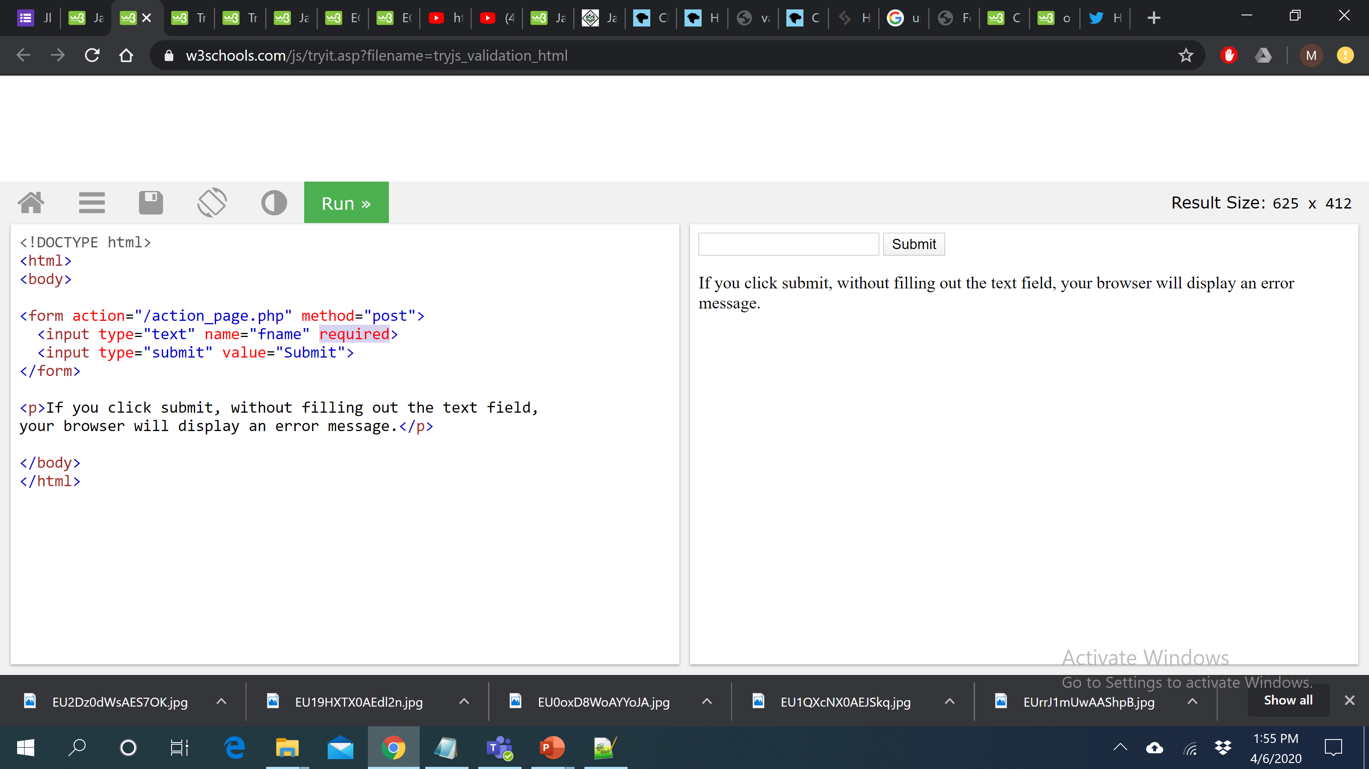
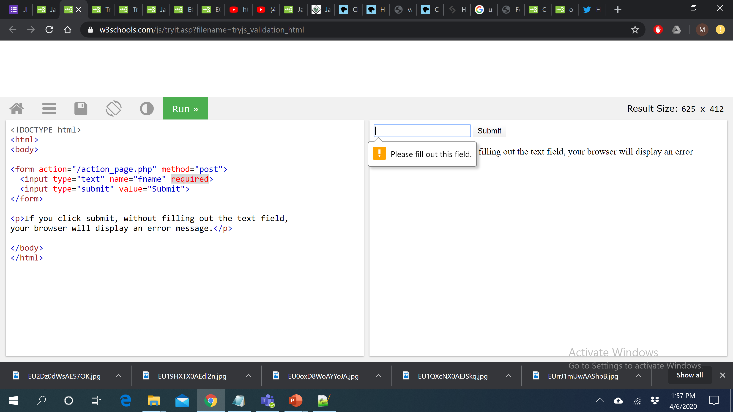
HTML5 Form Input Attributes – required attribute
The required attribute is a boolean attribute.
The input required attribute specifies that an input field must be filled out before submitting the form.
The required attribute works with the following input types: text, search, url, tel, email, password, date pickers, number, checkbox, radio, and file. It also works on the <select> and <textarea> elements.

Slide 31
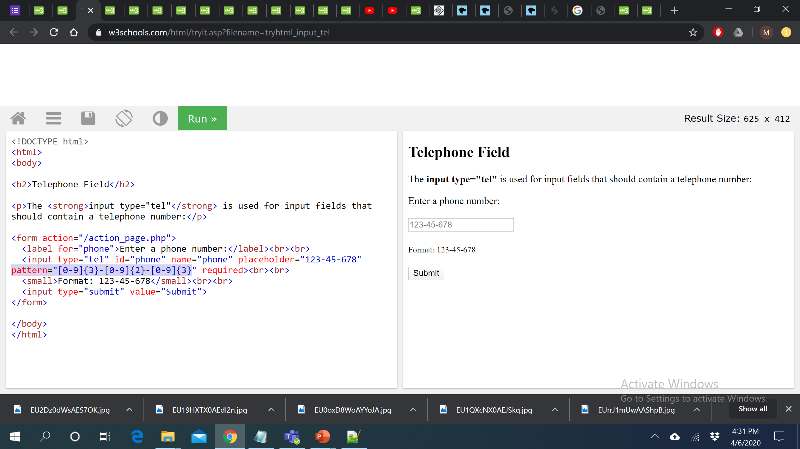
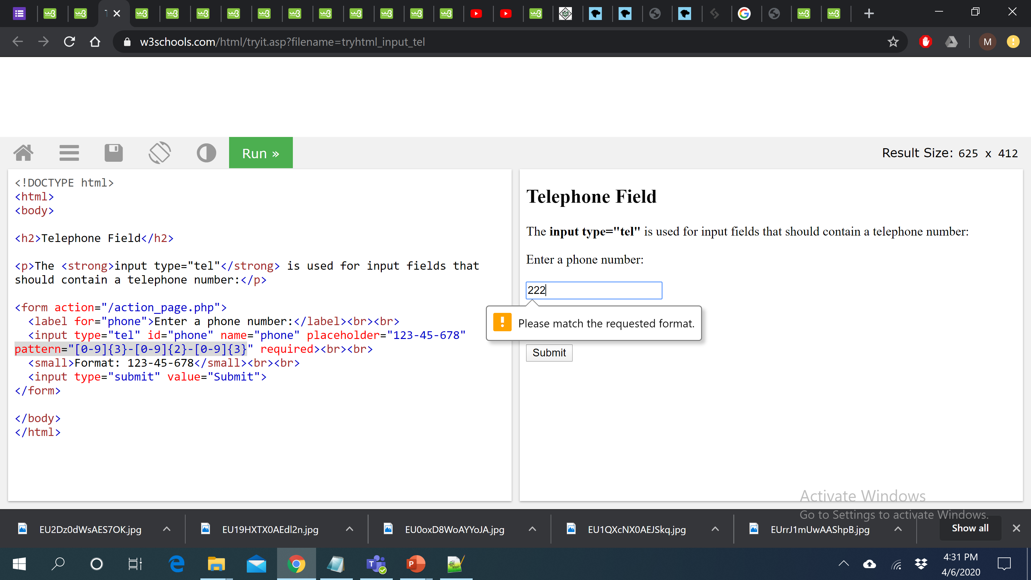
HTML5 Form Input Attributes – pattern attribute
The input pattern attribute specifies a regular expression that the input field's value is checked against, when the form is submitted.
The pattern attribute works with the following input types: text, date, search, url, tel, email, and password.
For example, the following example ensures the proper format of a telephone number.

Slide 32
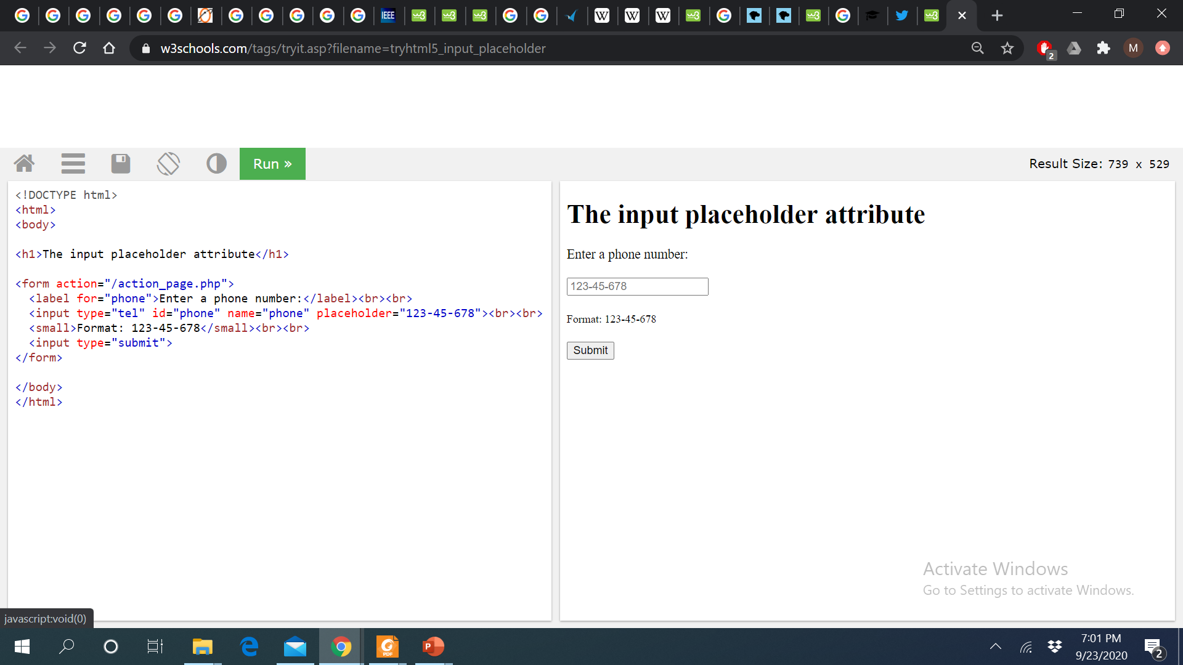
HTML5 Form Input Attributes – placeholder attribute
The placeholder attribute specifies a short hint that describes the expected value of an input field (e.g. a sample value or a short description of the expected format).
The short hint is displayed in the input field before the user enters a value.
The placeholder attribute works with the following input types: text, search, url, tel, email, and password.

Slide 33
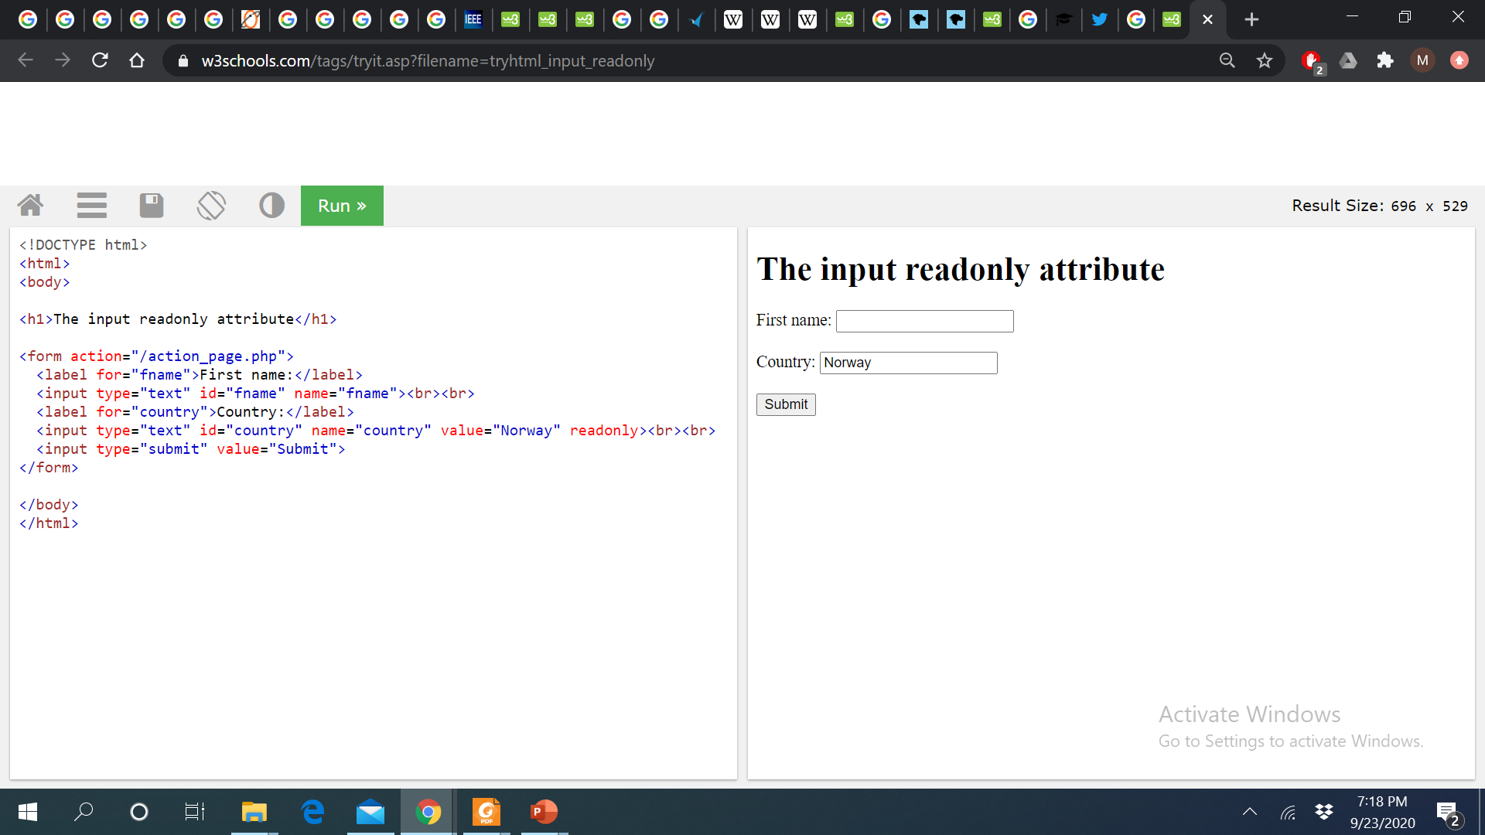
HTML5 Form Input Attributes – readonly attribute
The readonly attribute is a boolean attribute. When present, it specifies that an input field is read-only.
A read-only input field cannot be modified (however, a user can tab to it, highlight it, and copy the text from it).
The readonly attribute can be set to keep a user from changing the value until some other conditions have been met (like selecting a checkbox, etc.). Then, a JavaScript can remove the readonly value, and make the input field editable.
A form will still submit an input field that is readonly but will not submit an input field that is disabled!

Slide 34
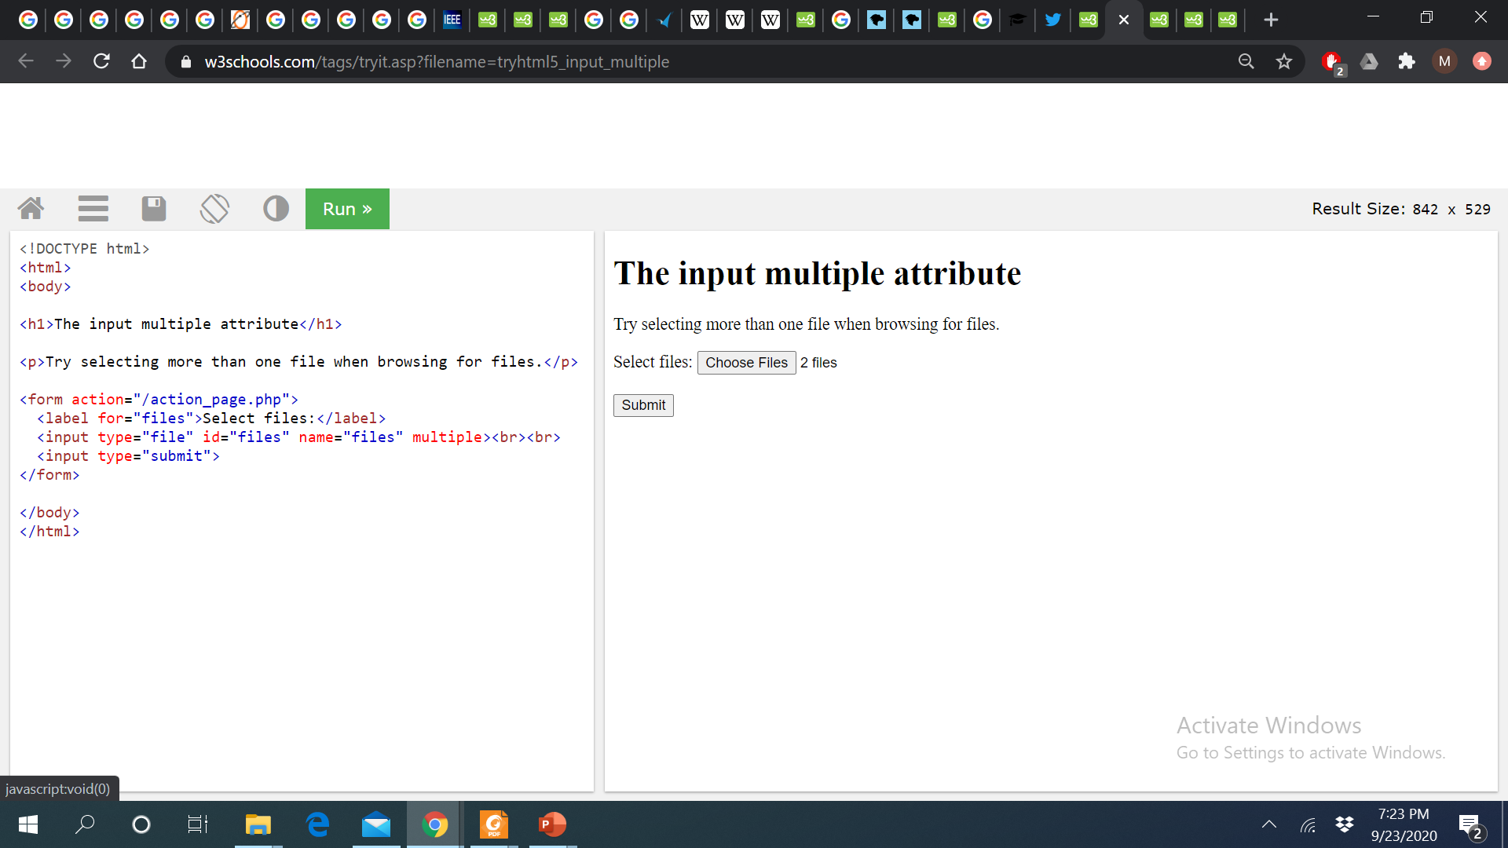
HTML5 Form Input Attributes – multiple attribute
The multiple attribute is a boolean attribute.
When present, it specifies that the user is allowed to enter more than one value in the <input> element.
The multiple attribute works with the following input types: email, and file.
For <input type="file">: to select multiple files, hold down the CTRL or SHIFT key while selecting.
For <input type="email">: separate each email with a comma, like: mail@example.com, mail2@example.com, mail3@example.com in the email field.

Slide 35
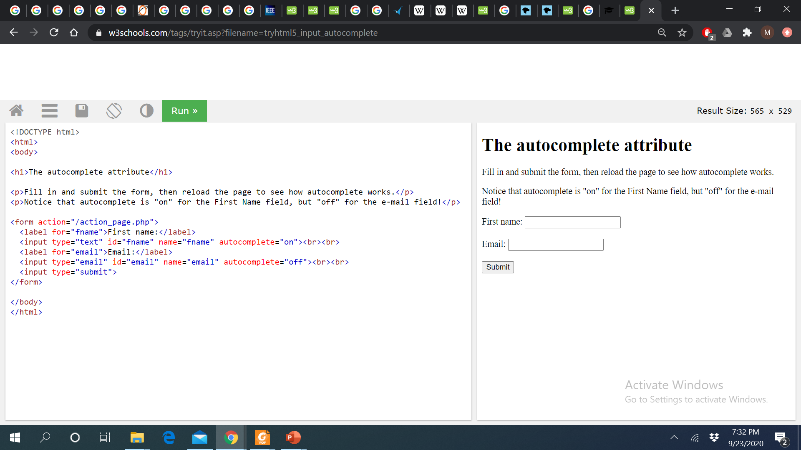
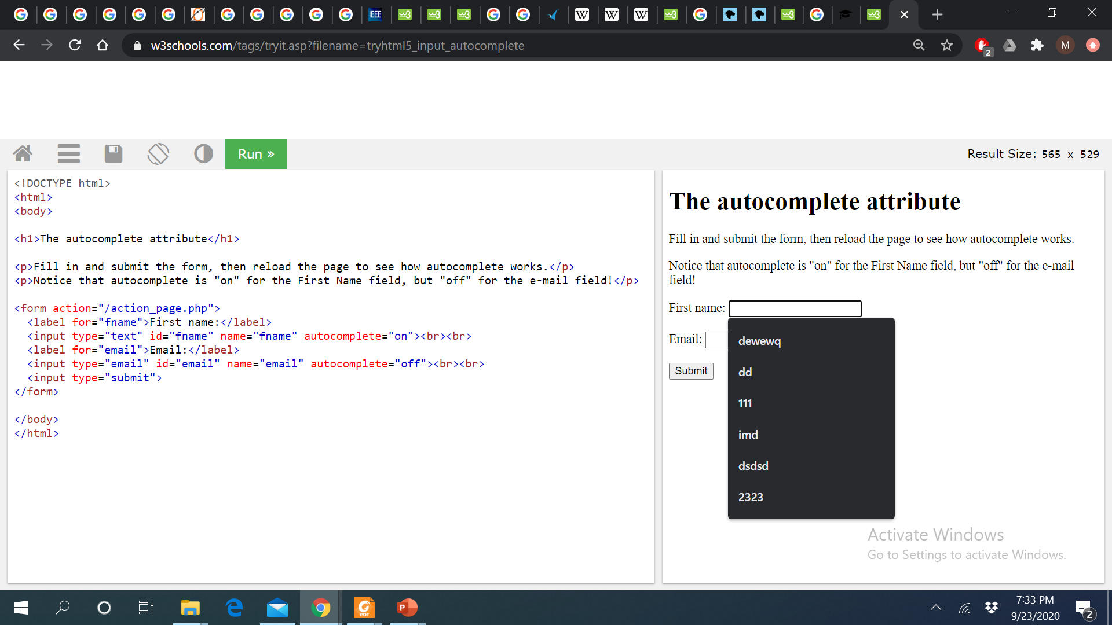
HTML5 Form Input Attributes – autocomplete attribute
The autocomplete attribute specifies whether or not an input field should have autocomplete enabled.
Autocomplete allows the browser to predict the value. When a user starts to type in a field, the browser should display options to fill in the field, based on earlier typed values.
The autocomplete attribute works with the following <input> types: text, search, url, tel, email, password, datepickers, range, and color.

Slide 36
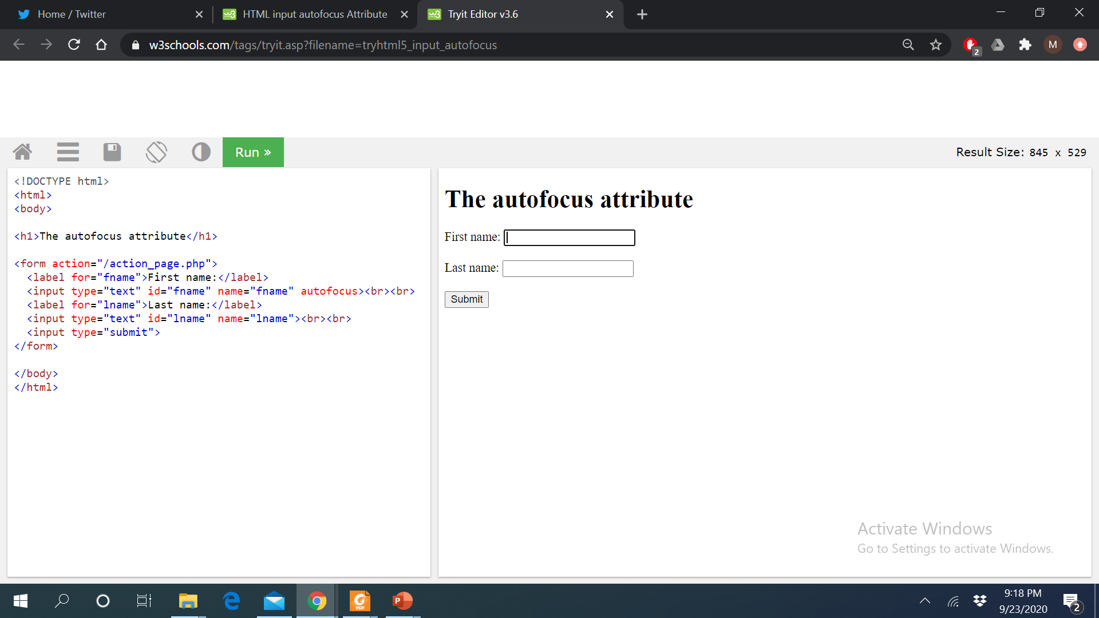
HTML5 Form Input Attributes – autofocus attribute
The autofocus attribute is a boolean attribute.
When present, it specifies that an <input> element should automatically get focus when the page loads.

Slide 37
Form Attributes
The Action Attribute
The action attribute defines the action to be performed when the form is submitted.
<form action="/action_page.php">
The Target Attribute
The target attribute specifies where to display the response t
hat is received after submitting the form.
The target attribute can have one of the following values:
The default value is _self which means that the response will open in the current window.
Value | Description
_blank | The response is displayed in a new window or tab
_self | The response is displayed in the current window
_parent | The response is displayed in the parent frame
_top | The response is displayed in the full body of the window
framename | The response is displayed in a named iframe

Slide 38
Form Attributes
The Method Attribute
The method attribute specifies the HTTP method to be used when submitting the form data.
The form-data can be sent as URL variables (with method="get") or as HTTP post transaction (with method="post").
The default HTTP method when submitting form data is GET.
Example
This example uses the GET method when submitting the form data:
<form action="/action_page.php" method="get">
Example
This example uses the POST method when submitting the form data:
<form action="/action_page.php" method="post">
Notes on GET:
Appends the form data to the URL, in name/value pairs
NEVER use GET to send sensitive data! (the submitted form data is visible in the URL!)
The length of a URL is limited (2048 characters)
Useful for form submissions where a user wants to bookmark the result
GET is good for non-secure data, like query strings in Google
Notes on POST:
Appends the form data inside the body of the HTTP request (the submitted form data is not shown in the URL)
POST has no size limitations, and can be used to send large amounts of data.
Form submissions with POST cannot be bookmarked
Tip: Always use POST if the form data contains sensitive or personal information!

Slide 39
HTML5 Audio and Video Tags
Before HTML5, there was no standard way to embed video into web pages. A plugin like Adobe’s Flash Player is controlled solely by Adobe and is not open to community development.
The introduction of the video and audio elements in HTML5 resolves this problem and makes multimedia a seamless part of a web page, the same as the img element.
With HTML5, there’s no need for the user to download third-party software to view your content, and the video or audio player is easily accessible via scripting.

Slide 40
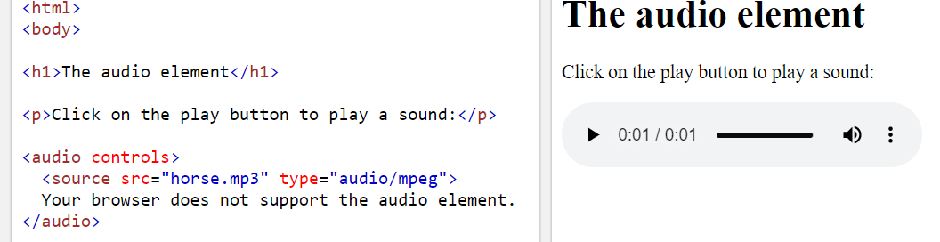
HTML 5 <audio> tag
The <audio> tag is used to embed sound content in a document, such as music or other audio streams.
The <audio> tag contains one or more <source> tags with different audio sources. The browser will choose the first source it supports.
The text between the <audio> and </audio> tags will only be displayed in browsers that do not support the <audio> element.
There are three supported audio formats in HTML: MP3, WAV, and OGG.

Slide 41
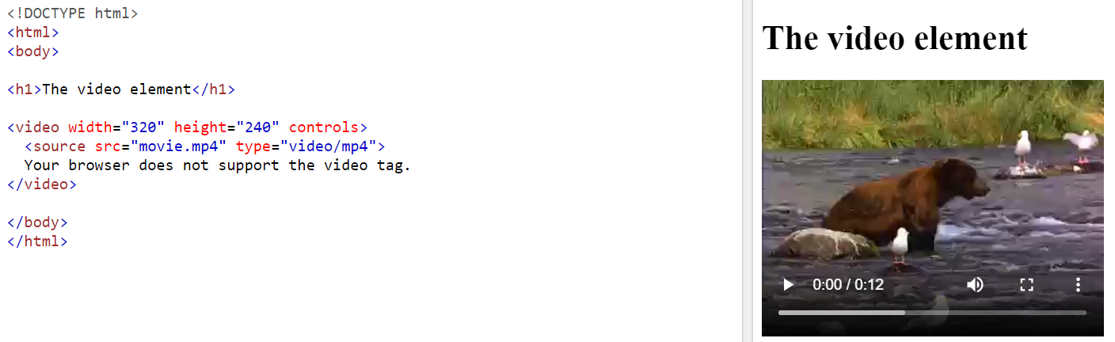
HTML 5 <video> tag
The <video> tag is used to embed video content in a document, such as a movie clip or other video streams.
The <video> tag contains one or more <source> tags with different video sources. The browser will choose the first source it supports.
The text between the <video> and </video> tags will only be displayed in browsers that do not support the <video> element.
There are three supported video formats in HTML: MP4, WebM, and OGG.

Slide 42
Summary of Today’s Lecture
HTML5 Introduction
HTML 5 Semantic Elements
HTML5 Forms
Input Types
Form Attributes
HTML5 Audio & Video Elements

Slide 43
References
The Best Way to Lay Out a Page with HTML5 | Developer.com
https://en.wikipedia.org/wiki/HTML5
HTML5 Semantic Tags: What They Are and How to Use Them! (semrush.com)
https://developer.mozilla.org/en-US/docs/Learn/Forms/HTML5_input_types
HTML5 and CSS3 for the real world by Alexis Goldstein, Louis Lazaris and Estelle Weyl.
CS142 Lecture Notes - Web Apps

